Slide 1
알고리즘
제작: 이 윤 열

Slide 2
1.1 알고리즘들
▣ [Algorithm 1.1] : Sequential Search Algorithm
Problem: Is the key x in the array S of n keys?
Input: (parameters): Positive integer n, array of keys S indexed from 1 to n, and a key x.
Output: location, the location of x in S (0 if x is not in S).
void seqsearch (int n, const keytype S[ ], keytype x, index location) { location = 1; while (location <= n && S[location] != x ) location++; if (location > n) { location = 0; }

Slide 3
▣ [문제] : 다음과 같은 조건일 때, Sequential Search 알고리즘을 이용하여 프로그램을 작성하시오.
S = [10, 7, 11, 5, 13, 8],
n = 6,
x = 5

Slide 4
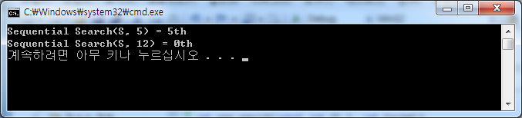
● [ C Program ] (seq_search)
#include <stdio.h> int seq_search(const int S[ ], int target); void main() { const int S[ ] = {1, 2, 3, 4, 5, 6, 7, 8, 9, 10}; printf("Sequential Search(S, 5) = %dth\n", seq_search(S, 5)+1); printf("Sequential Search(S, 12) = %dth\n", seq_search(S, 12)); } int seq_search(const int *S, int target) { int i; for(i = 0; i <= 9; i++) if(S[i] == target) return i; return (0); }

Slide 5
▣ [Algorithm 1.3] : Exchange Sort
Problem: Sort n keys in nondecreasing order.
Input: Positive integer n, array of keys S indexed from 1 to n.
Output: the array S containing the keys in nondecreasing order.
void exchangesort (int n, keytype S[ ]) { index i, j; for (i = 1, i <= n; i++) for (j = i+1, j <= n; j++) if (S[j] < S[i]) exchange S[i] and S[j]; }

Slide 6
▣ [문제] : 다음과 같은 조건일 때, Exchange Sort 알고리즘을 이용하여 오름차순으로 정렬하는
프로그램을 작성하시오.
S = [10, 7, 11, 5, 13, 8]
n = 6

Slide 7
▣ [Algorithm 1.4] : Matrix Multiplication
Problem: Determine the product of two n x n matrics.
Input: a positive integer n, 2-dimensional arrays of number A and B,
each of which has both its rows and columns indexed from 1 to n.
Output: a 2-dimensional array of numbers C,
which its rows and columns indexed from 1 to n, containing the product of A and B.
void matrixmult(int n, const number A[ ][ ], const number B[ ][ ], number C[ ][ ]) { index i, j, k; for (i = 1; i <= n; i++) for (j = 1; j <= n; j++) { C[i][j] = 0; for (k = 1; k <= n; k++) C[i][j] = C[i][j] + A[i][k] * B[k][j]; } }

Slide 8

▣ [문제] : 다음과 같은 조건일 때, 위의 matrixmult( ) 알고리즘을 이용하여 프로그램을 작성하시오.
A = $\left[\begin{matrix}2 & 3 \\ 4 & 1\end{matrix}\right]$ and B = $\left[\begin{matrix}5 & 7 \\ 6 & 8\end{matrix}\right]$
∴ C = $\left[\begin{matrix}28 & 38 \\ 26 & 36\end{matrix}\right]$

Slide 9
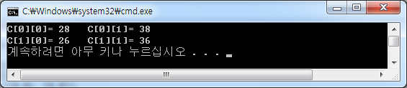
#include <stdio.h> void matrixmul(int, const int A[][2], const int B[][2], int C[][2]); int n = 2; const int A[2][2] = {{2,3}, {4,1}}; const int B[2][2] = {{5,7}, {6,8}}; int C[2][2] = {{0,0}, {0,0}}; void main() { matrixmul(n, A, B, C); } void matrixmul(int, const int A[][2], const int B[][2], int C[][2]) { int i, j, k; for(i = 0; i <= n-1; i++) for(j = 0; j <= n-1; j++) { C[i][j] = 0; for(k = 0; k <= n-1; k++) C[i][j] = C[i][j] + A[i][k] * B[k][j]; } for(i = 0; i <= n-1; i++) { for(j = 0; j <= n-1; j++) { printf("C[%d][%d]= %d ", i, j, C[i][j]); } printf("\n"); } }

Slide 10
▣ [Algorithm 1.6] : Fibonacci Sequence
n^{th} Fibonacci Term (Recursive)
Problem: Determine the n^{th} term in the Fibonacci Sequence.
Inputs: a nonnegative integer n.
Outputs: fib, the n^{th} term of the Fibonacci Sequence.
int fib (int n) { if (n <= 1) return n; else return fib(n-1) + fib(n-2); }

Slide 11
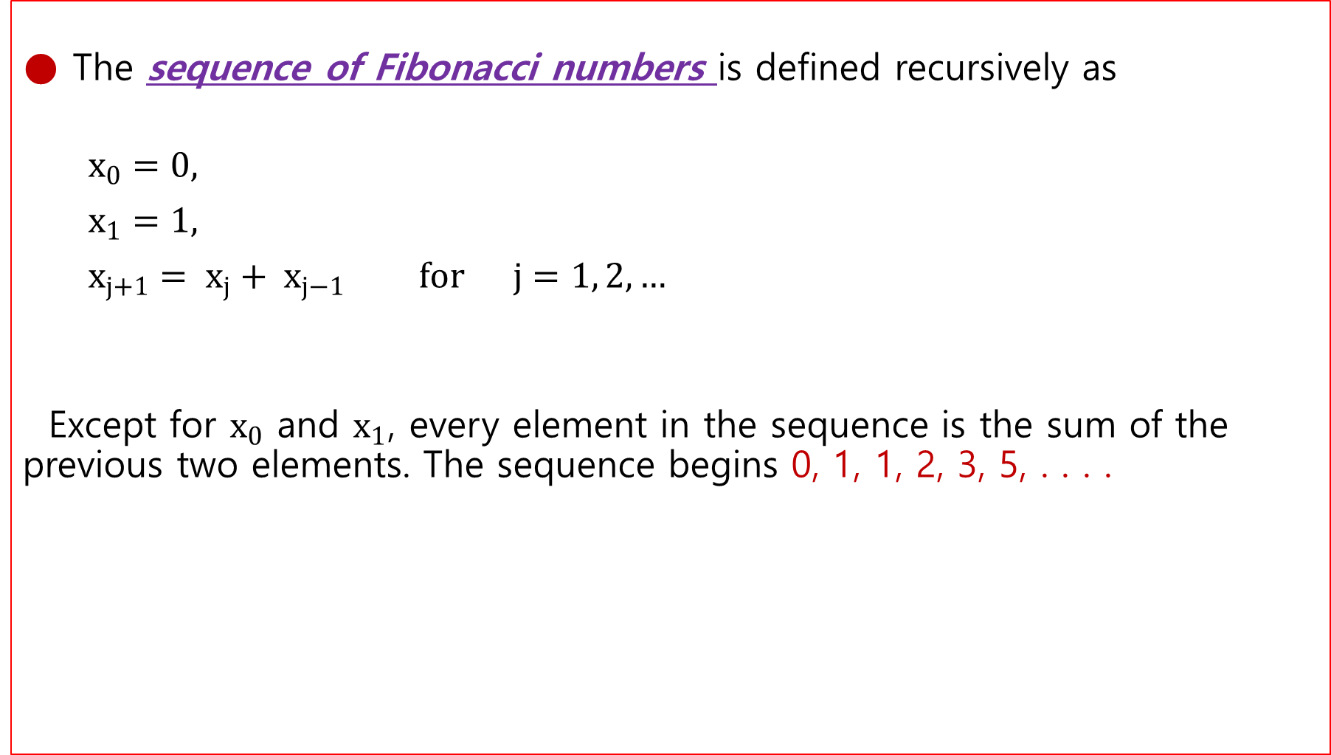
● The sequence of Fibonacci numbers is defined recursively as
$x_{0}=0,$
$x_{1}=1,$
$x_{j+1}= x_{j}+ x_{j−1} for j=1, 2, …$
Except for $x_{0}$ and $x_{1}$, every element in the sequence is the sum of the previous two elements. The sequence begins 0, 1, 1, 2, 3, 5, . . . .

Slide 12
▣ [문제] : 다음과 같은 조건일 때, 위의 Fibonacci Sequence 알고리즘을 이용하여
프로그램을 작성하시오.
n = 5 (즉, fib(5) 일때)

Slide 13
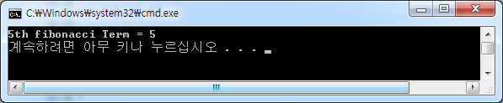
▣ [C 프로그램]
#include <stdio.h> int fib(int n); void main() { int n = 5; printf(" 5th fibonacci Term = %d\n", fib(n)); } int fib(int n) { if(n <= 1) return (n); else return (fib(n-1) + fib(n-2)); }

Slide 14
▣ [Algorithm 1.7] : n^{th} Fibonacci Sequence
n^{th} Fibonacci Term (Iterative)
int fib2 (int n) { index i; int f[0 . . n]; f[0] = 0; if (n > 0) { f[1] = 1; for (i=2; i<=n; i++) f[i] = f[i-1] + f[i-2]; } return f[n]; }

Slide 15
▣ [Recursive Functions] :
The more advanced uses of functions are described in this chapter. Especially important is recursion, which occurs whenever a function invokes an instance of itself, either directly or indirectly. Some programming tasks are naturally solved with the use of recursion. Also described in this chapter is the mechanism used to pass function as arguments.
1.6.1 Recursion
- A function is said to be recursive if it calls itself, either directly or indirectly.
- In C all functions can be used recursively.
- In its simplest from the idea of recursion is straightforward.
- Try the following program.

Slide 16
▣ [예제 1] :
main( ) ( printf(“ The universe is never ending! “); main( ); }

Slide 17
▣ [예제 2] :
Another simple example of recursive function is the following.
It computes the sum of the first n positive integer.
int sum(int n) ( if (n <= 1) return (n); else return (n + sum(n-1)); }

Slide 18
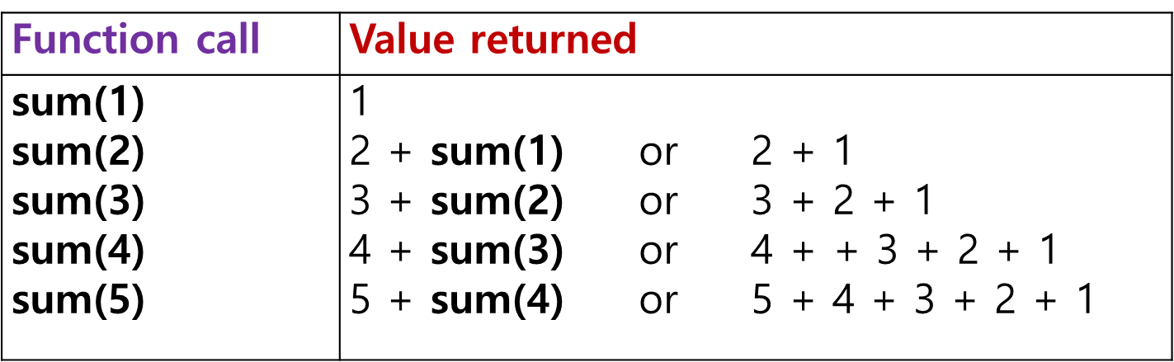
- Simple recursive routines follow a standard template.
- Typically there is base case (or cases) that is tested for upon entry to the function..
- In sum( ) the variable n was reduced by 1 each time
until the base case with n equal to 1 was reached.

Slide 19
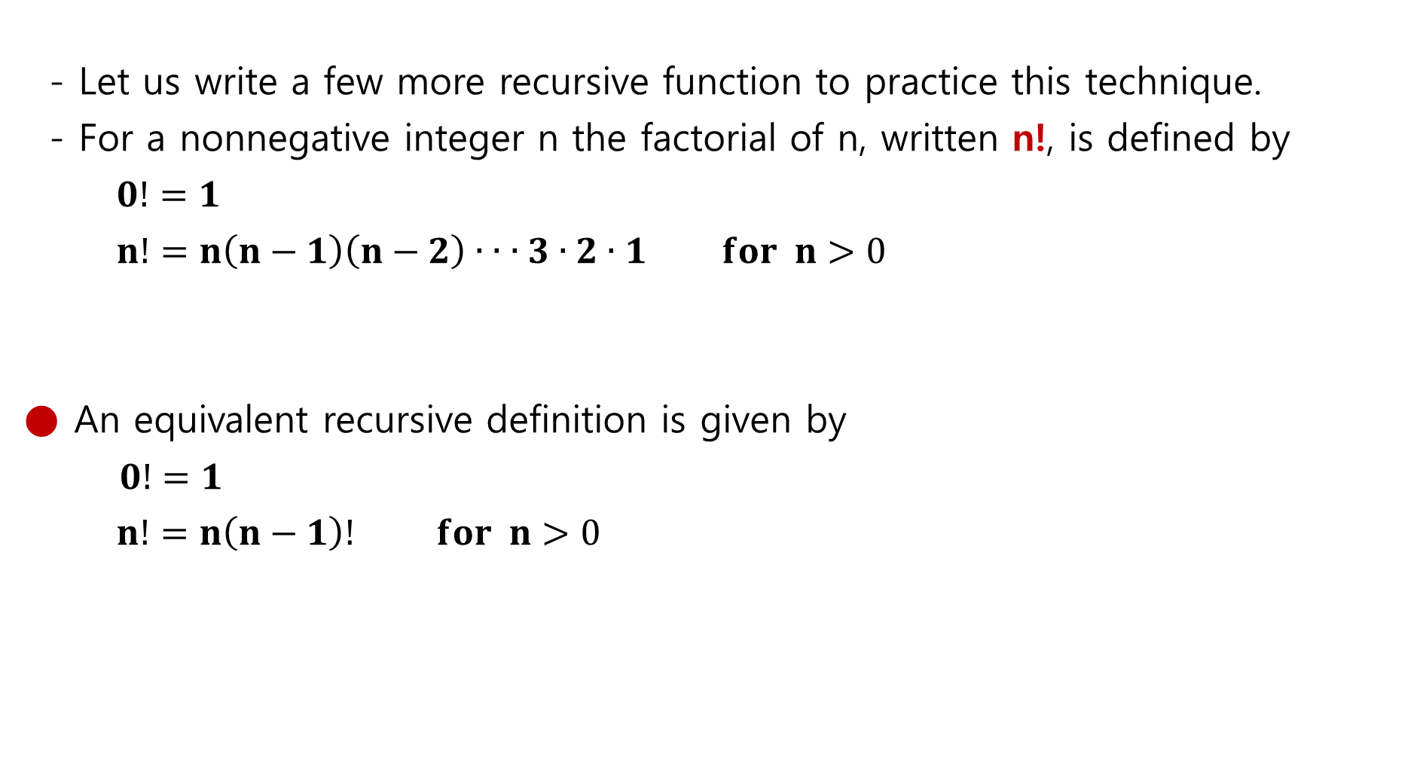
- Let us write a few more recursive function to practice this technique.
- For a nonnegative integer n the factorial of n, written n!, is defined by
$0!=1$
$n!=n\left(n−1\right)\left(n−2\right)∙ ∙ ∙3∙2∙1 for n>0$
● An equivalent recursive definition is given by
$0!=1$
$n!=n\left(n−1\right)! for n>0$

Slide 20
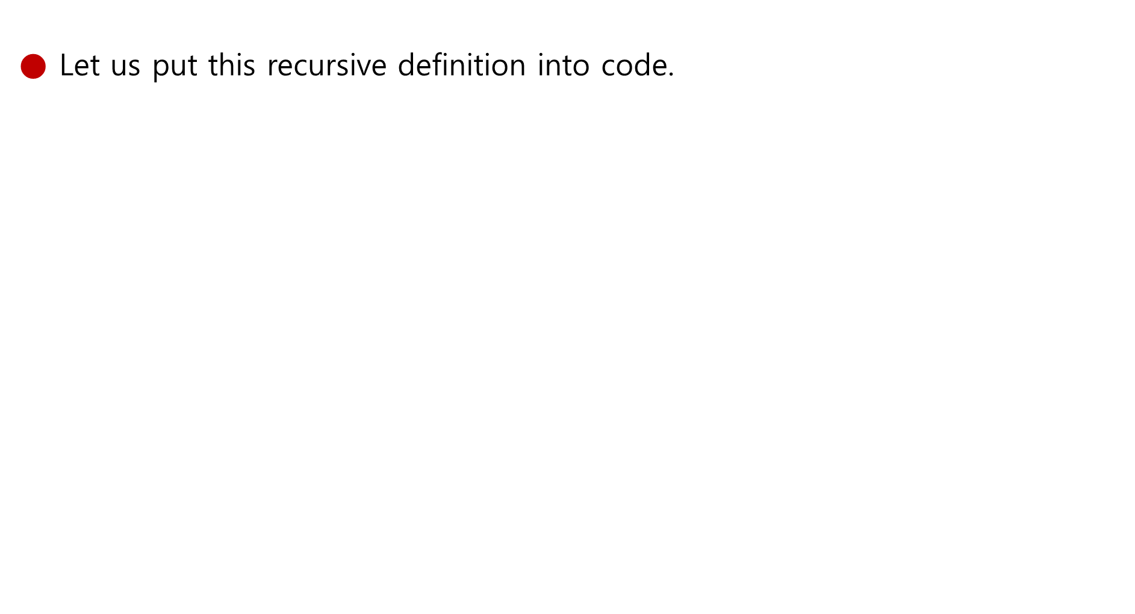
● Let us put this recursive definition into code.
int factorial(int n) // recursive version { if (n <= 1) return (1); else return (n * factorial(n-1)); }

Slide 21
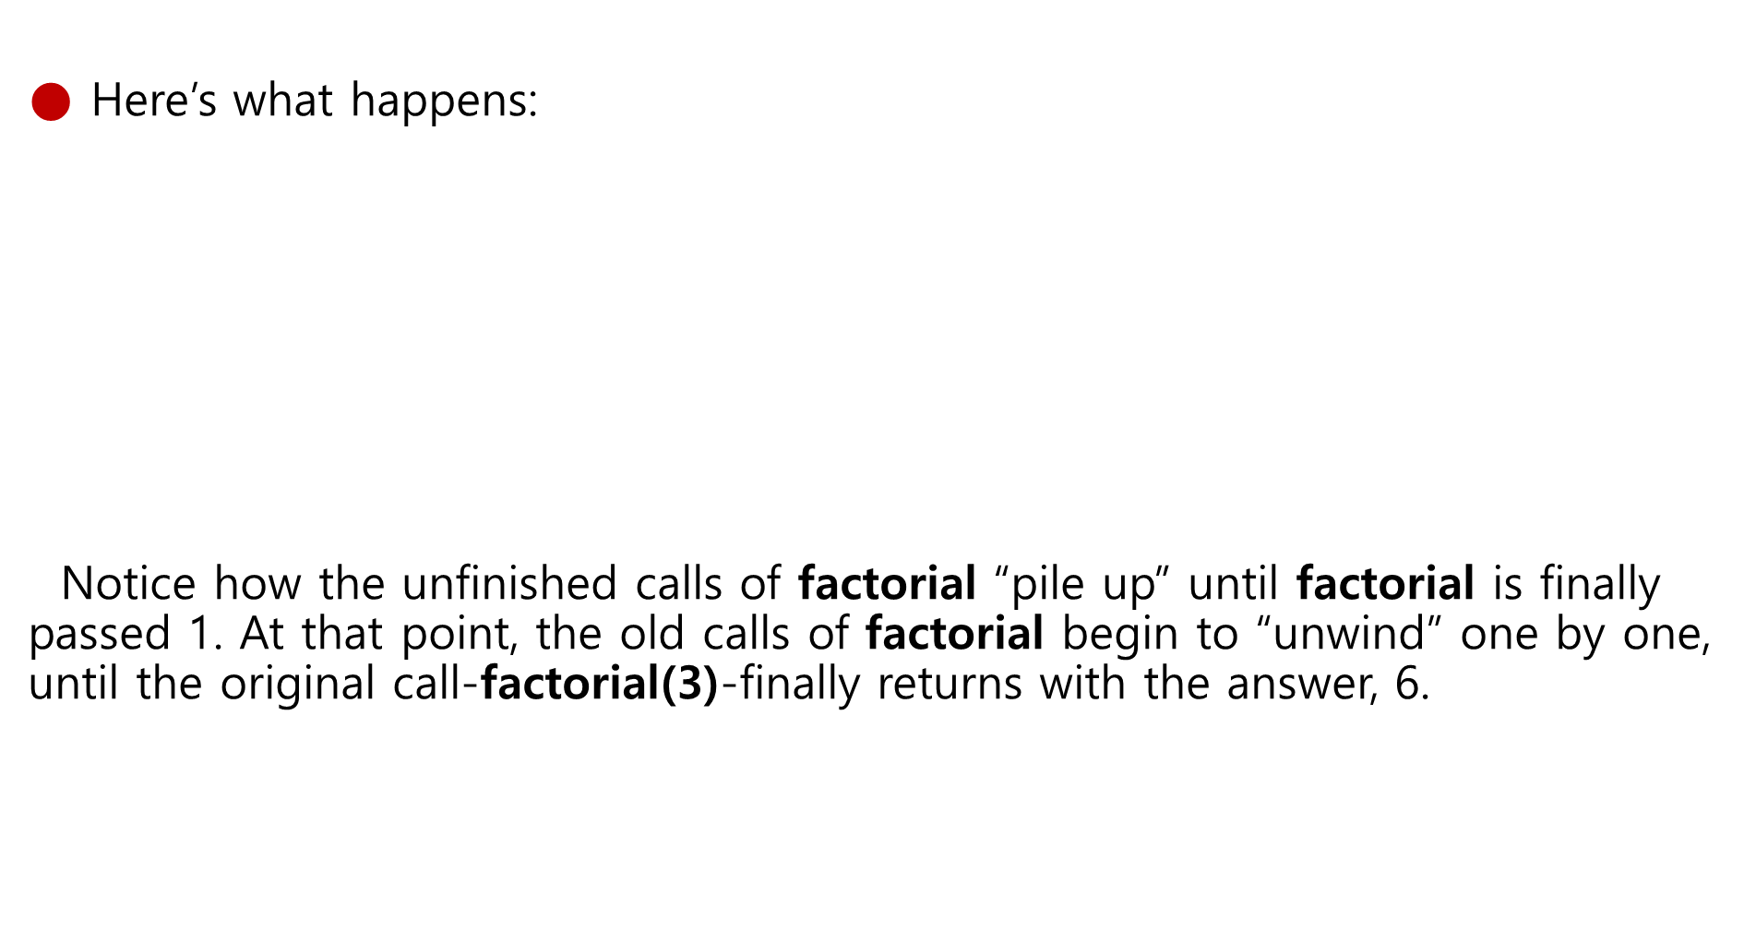
● Here’s what happens:
Notice how the unfinished calls of factorial “pile up” until factorial is finally passed 1. At that point, the old calls of factorial begin to “unwind” one by one, until the original call-factorial(3)-finally returns with the answer, 6.
factorial(3) finds that 3 is not less than or equal to 1, so it calls fact(2), which finds that 2 is not less than or equal to 1, so it calls fact(1) which finds that 1 is less than or equal to 1, so it returns 1, causing fact(2) to return 2 x 1 = 2, causing factorial(3) to return 3 x 2 = 6.

Slide 22
● Most simple recursive functions can be easily rewritten as iterative functions.
For a given nonnegative input value; both factorial functions return the same value, but the iterative version requires only one function call regardless of the value passed in.
int factorial(int n) // iterative version { int product; for (product = 1; n > 1; --n) product = n * product;; return (product); }

Slide 23

● Here’s another example of recursion: a function that computes $x^{n}$,
using the formula $x^{n}=x • x^{n−1}$.
int power (int x, int n) { if (n == 0) return (1); else return (x * power(x, n-1)); }

Slide 24
● The call power(5, 3) would be executed as follows:
power(5, 3) finds that 3 is not equal to 0, so it calls power(5, 2), which finds that 2 is not equal to 0, so it calls power(5, 1), which finds that 2 is not equal to 0, so it calls power(5, 0) which finds that 1 is equal to 0, so it returns 1, causing power(5, 1) to return 5 x 1 = 5, causing power(5, 2) to return 5 x 5 = 25, causing power(5, 3) to return 5 x 25 = 125.

Slide 25
● Incidentally, we can condense the power function a bit by putting
a conditional expression in the return statement
int power (int x, int n) { return n == 0 ? 1 : x * power(x, n-1); }

Slide 26
1-3. 알고리즘 효율성(Algorithm Efficiency)과 정확성
● Measured as number of instructions executed
● Big theta notation: Used to represent efficiency classes
- Example: Insertion sort is in Θ(n²)
● Best(Ω), worst(Ο), and average case(Θ) analysis

Slide 27
※ [참고] 문제의 복잡도(Complexity of Problems)
● Time Complexity: The number of instruction executions required
- Unless otherwise noted, “complexity” means “time complexity.”
● A problem is in class O(f(n)) if it can be solved by an algorithm
in Θ(f(n)).
● A problem is in class Θ(f(n)) if the best algorithm to solve it is
in class Θ(f(n)).

Slide 28
● O(f(n))은 점근적 증가율이 f(n)을 넘지 않는 모든 함수들의 집합.
즉, 최고차항의 차수가 f(n)과 일치하거나 더 작은 함수들의 집합.
● (예 1) :
$\lim_{x→∞}{\frac{{2n}^{2}+3n}{n}} =2n+3$ = O(n)
● (예 2) :
${5n}^{2}+4$n = O($n^{2}$)
7n = O($n^{2}$)
${3n}^{2}$ - 50 = O($n^{2}$)
2n + 1 = O($n^{2}$)
7n의 증가율이 $n^{2}$의 증가율을 넘지 않는다.

Slide 29
● Θ(f(n)) 은 점근적 증가율이 f(n)과 일치하는 모든 함수들의 집합.
즉, Θ(f(n))은 최고차항의 차수가 f(n)과 일치하는 함수들의 집합.
● (예) :
${5n}^{2}+4$n = Θ($n^{2}$)
$n^{2}$ = Θ($n^{2}$)
${3n}^{2}$ - 50 = Θ($n^{2}$)
${ 7n}^{2}$ + 15 = Θ($n^{2}$)
${ 2n}^{2}$ + 3n$logn$ = Θ($n^{2}$)
${ n}^{2}$ + $\sqrt{n}$ = Θ($n^{2}$)

Slide 30
● Ω(f(n)) 은 점근적 증가율이 적어도 f(n)이 되는 모든 함수들의 집합.
다시말하면, Ω(f(n))은 최고차항의 차수가 f(n)과 일치 하거나 더 큰 함수의
집합이다. 즉, Ω −표기는 함수의 점근적 하한을 나타낸다.
● (예) :
${5n}^{2}+4$n = Ω ($n^{2}$)
${7n}^{3}$ = Ω ($n^{2}$) : ${7n}^{3}의$ 증가율은 $n^{2}$의 증가율보다 크기 때문이다.
${3n}^{2}−50$= Ω ($n^{2}$)
${5n}^{3}+15$ = Ω ($n^{2}$)

Slide 31
● Graphs of the mathematical expressions n, log₂ n, n log₂ n,
and n²

Slide 32
※ [참고] P versus NP
● Class P: All problems in any class Θ(f(n)), where f(n) is a
polynomial
● Class NP: All problems that can be solved by a nondeterministic
algorithm in polynomial time
Nondeterministic algorithm = an “algorithm” whose steps may not be
uniquely and completely determined by the process state
● Whether the class NP is bigger than class P is currently unknown.

